Slide 1
Period 4: The Missouri Compromise (Compromise of 1820)
Everything You Need to Know About The Missouri Compromise To Succeed In APUSH

Slide 2
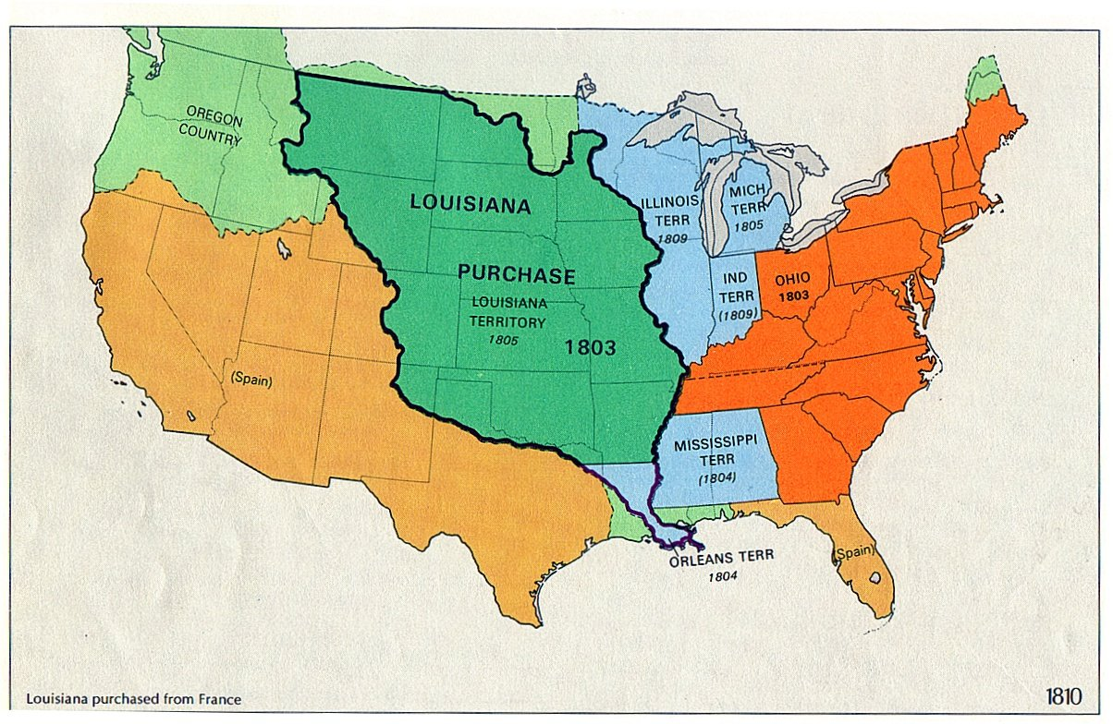
Background Leading to the Compromise
22 states in the country; 11 free, 11 slave
Missouri applied for statehood in 1819
Part of Louisiana Purchase territory
Tallmadge Amendment:
Would allow for emancipation of children of slaves
House favored it, Senate rejected it
South feared that this could lead to eventual abolition of slavery

Slide 3
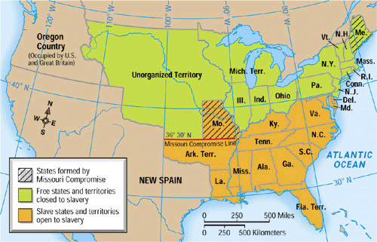
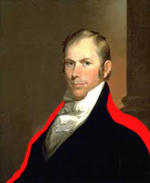
Enter Henry Clay!
Clay helped mollify the dispute
1st of 3 major Compromises mediated by Clay
Tariff Compromise of 1833 and Compromise of 1850
3 Parts of the Compromise
Missouri is added as a slave state
Maine is added as a free state (land belonged to Massachusetts)
All future states in LA Purchase Territory above 36°30’ would be free, all below would be slave

Slide 4
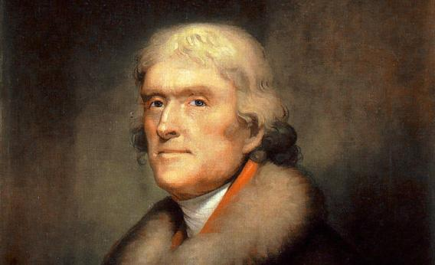
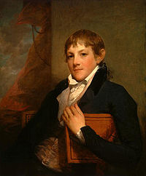
Problem(s) solved?
Source: Thomas Jefferson to John Randolph, April 22, 1820
[T]his momentous question, like a firebell in the night, awakened and filled me with terror. I considered it, at once as the [death] knell of the Union. It is hushed, indeed, for the moment. But this is a reprieve only, not a final sentence. A geographical line, coinciding with a marked principle, moral and political, once conceived and held up to the angry passions of men, will never be obliterated; and every new irritation will mark it deeper and deeper.
Did you know I got into a duel with Henry Clay?
Yes??????
Balance of free and slave states equal at 12
States admitted alternating free and slave in short-term future
Lasted 34 years
No??????
Jefferson disliked the compromise, “a firebell in the night”
In the future, there is a strong desire to keep states equal
Slavery would become the prominent issue for the next 40 years

Slide 5
Past Essay Topics
Analyze the effectiveness of political compromise in reducing sectional tensions in the period 1820 to 1861. (2004 Free Response)
In the early nineteenth century, Americans sought to resolve their political disputes through compromise, yet by 1860 this no longer seemed possible. Analyze the reasons for this change. Use the documents and your knowledge of the period 1820-1860 in constructing your response. (2005 Form B DBQ)
Analyze how western expansion contributed to growing sectional tensions between the North and the South. Confine your answer to the period from 1800 to 1850. (2012 Free Response)

Slide 6


Thanks for watching!
Subscribe to my channel
Help spread the word
Questions? Comments? Ideas for videos?
Leave in comments
My greatest compromise? Getting people to subscribe!
Subscribe
Down here!

